Slide 1

Technical Project II
Predictive Analytics for
YouTube Trending Videos
Arya Sasi
L00179434
MSc Big Data Analytics

Slide 2

INTRODUCTION
In this Technical Project 2, the goal is to employ advanced Machine learning techniques, specifically two ensemble methods. Our “YOUTUBE “ dataset includes information from different Countries.

Slide 3

The dataset consists of a daily record of the top trending YouTube videos.
Each region’s data is in a separate file. Data includes:
Video Title
Channel title
Publish time
Tags
Views
Likes
Dislikes
Description
Comment count
There are multiple csv files in the dataset, each corresponding to a specific country. As a first step you need to read them and combine these csv files into a single dataframe.

Slide 4
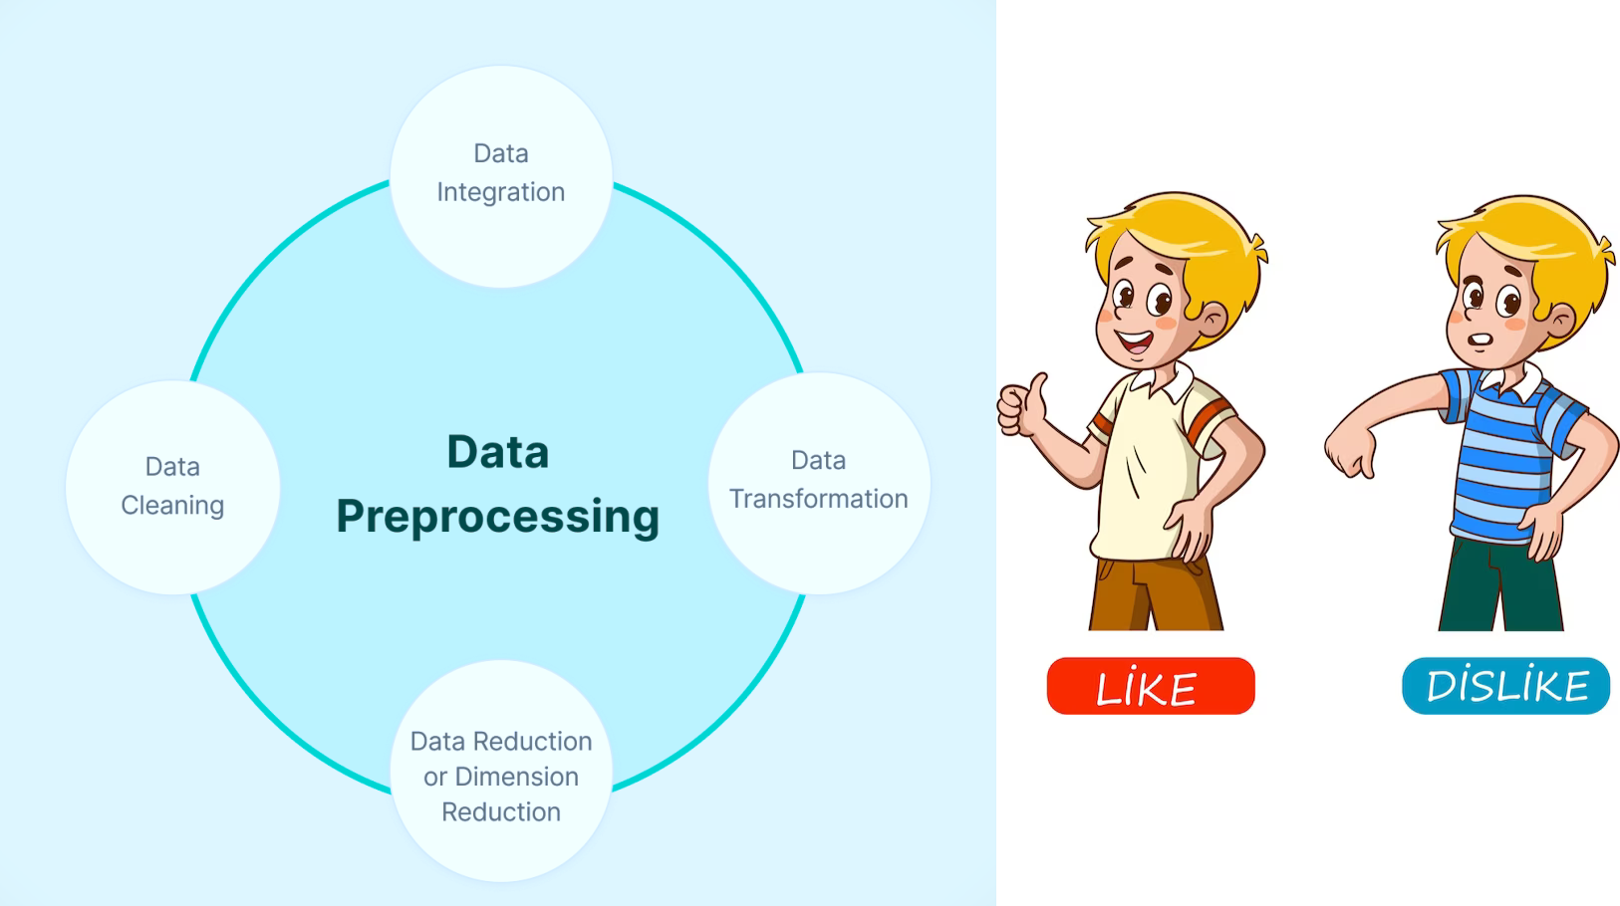
Feature Engineering: The primary object of feature engineering is to extract features using domain knowledge. It aims to extract features from raw data using various data mining approaches.
Exploratory Data Analysis: EDA aims to analyze data sets by summarizing its key characteristics assisted by visualizations.

Slide 5
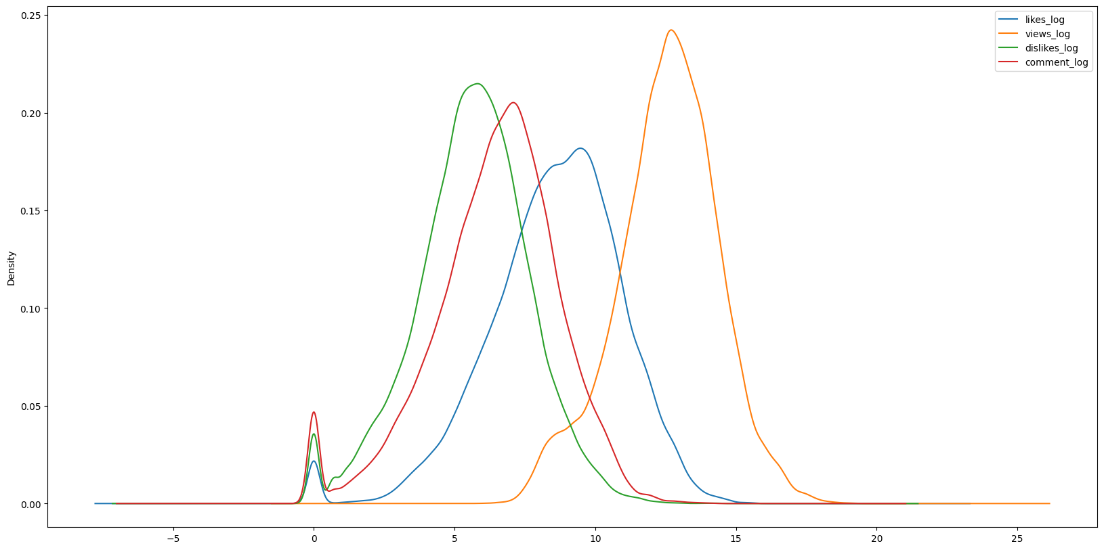
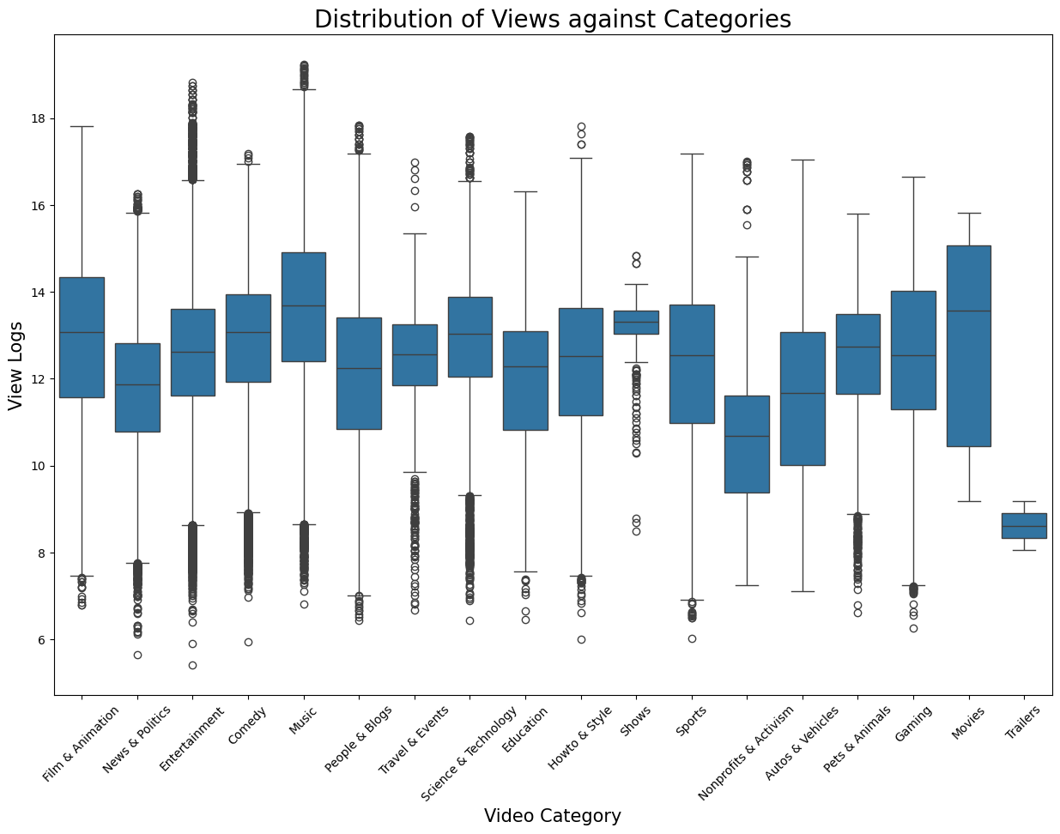
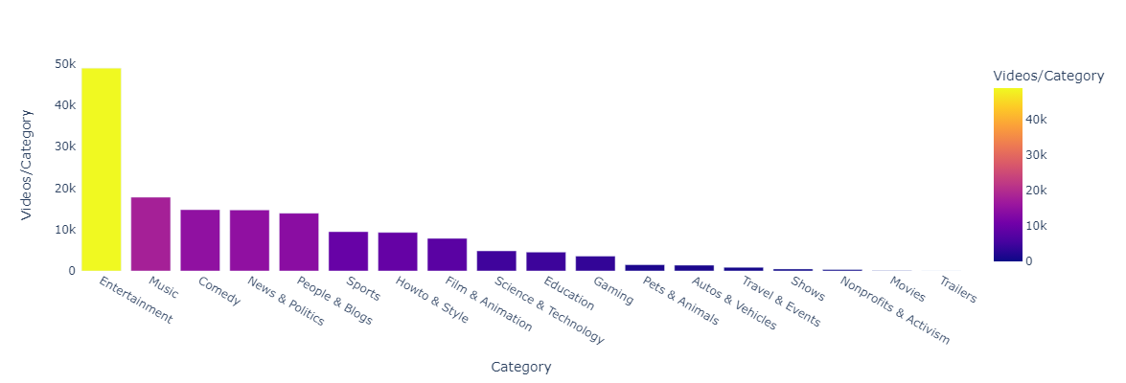
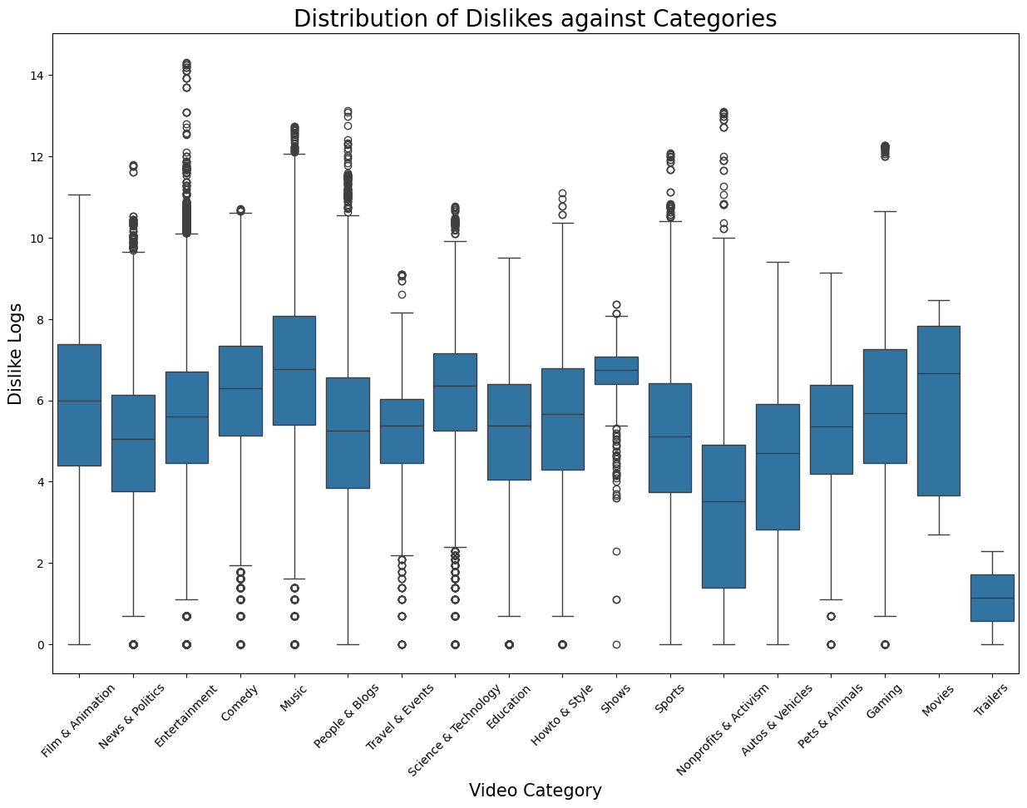
These are some of Visualization of datas in the dataset.

Slide 6
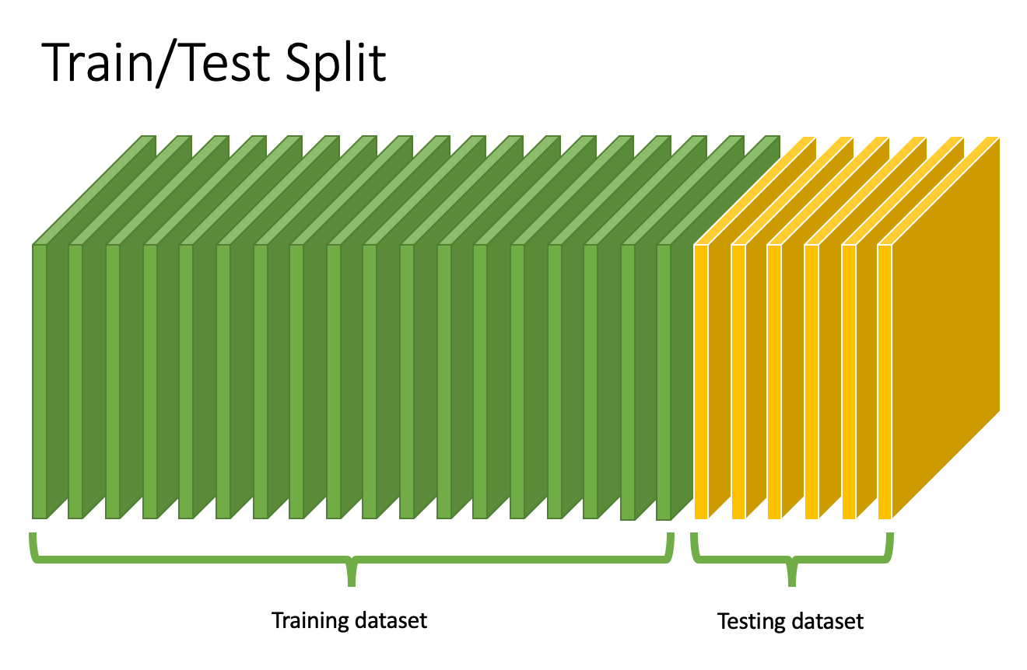
Scikit-learn is a free software machine learning library for the Python programming language. It features various classification, regression and clustering algorithms
Use sklearn's train_test_split library
split data into train and test sets
80% for training ,20% for testing.

Slide 7

QUESTIONS
What ensemble models can be employed to enhance predictive performance in machine learning tasks?
Which algorithm appears to be more suitable for the characteristics of the dataset?

Slide 8

Motivation to Model Section
Ensemble models are machine learning models that combine the predictions of multiple base models to improve overall performance. The idea behind ensemble methods is to leverage the diversity of individual models to create a stronger, more robust predictive model.

Slide 9

AdaBoost (Adaptive Boosting) can also be used for regression tasks, and in this context, it's called AdaBoostRegressor. While AdaBoost is often associated with classification problems, it can be adapted to regression by modifying the way it combines the predictions of weak learners.

Slide 10
Architecture:
Sampling by Weight
Dx1
Regressor 1
Adjust Weight of Dx
Prediction loss Assessment
w1
Sampling by Weight
Dx2
Regressor 2
w2
Dx
Σ
Ultimate Regressor
Adjust Weight of Dx
Prediction loss Assessment
wk
Sampling by Weight
Dxk
Regressor k

Slide 11

‘HistGradientBoostingRegressor’ is a regression algorithm implemented in scikit-learn. It is based on histogram-based gradient boosting, which is an efficient variant of traditional gradient boosting methods.

Slide 12
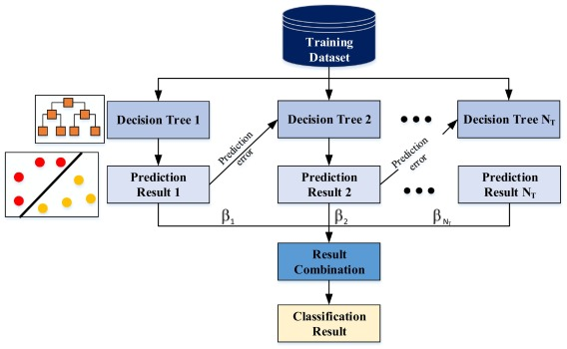
Architecture:
Regression Result

Slide 13


Slide 14


Slide 15
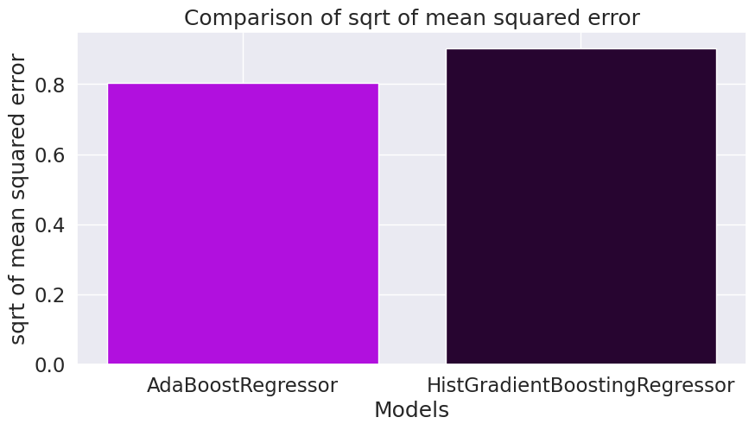
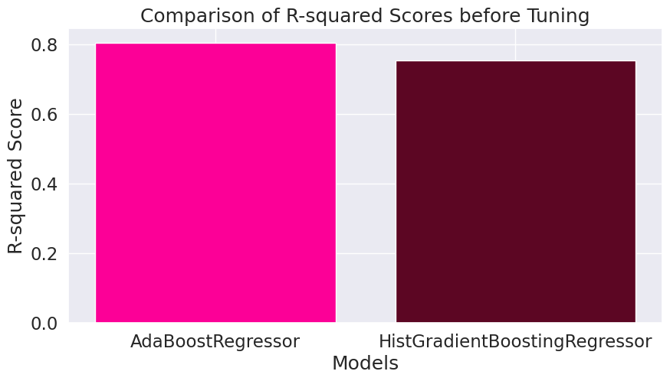
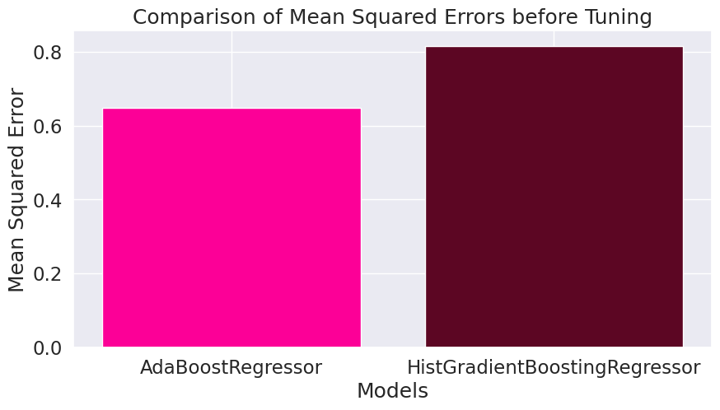
AdaboostRegressor is having less Mean Squared Error and higher R-Squared Score compared to HistgradientBoosting Algorithm, So we can say that the AdaboostRegressor Model is Suitable for this Data.

Slide 16
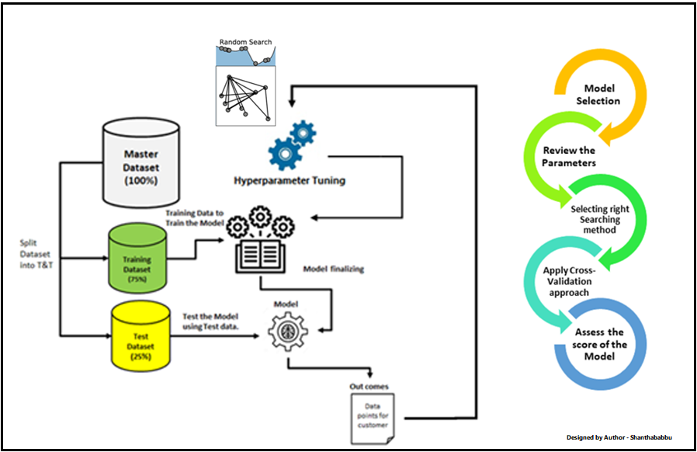
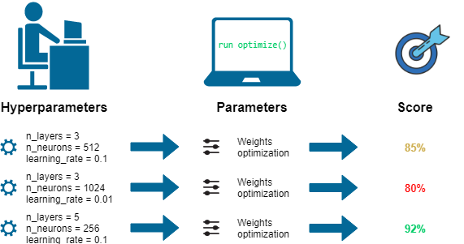
Hyperparameter Tuning

Slide 17
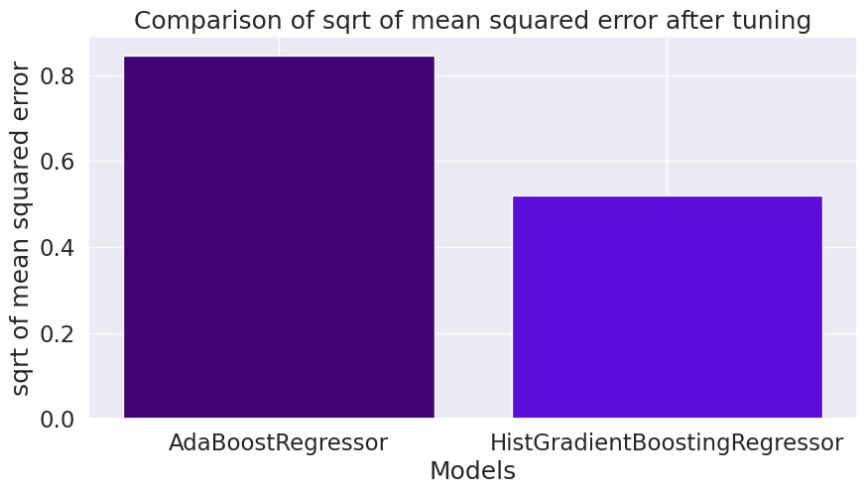
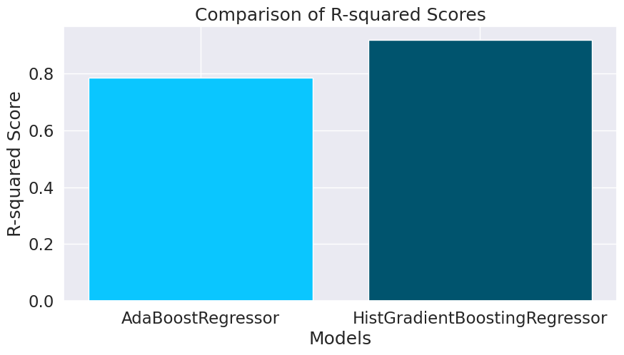
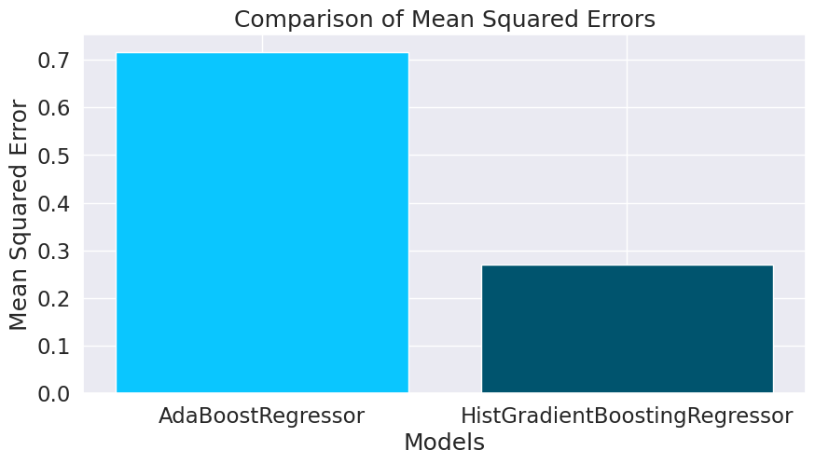
HistgradientBoosting Algorithm is having less Mean Squared Error and higher R-Squared Score compared to AdaboostRegressor Algorithm, So we can say that the HistgradientBoosting Model is suitable for this Dataset after Tuning.

Slide 18

DISCUSSIONS
Upon evaluating the outcomes, AdaBoostRegressor demonstrated a reasonably good fit, achieving an R-squared score of 0.80. The model exhibited moderate prediction errors on both the test (0.65) and training (0.65) datasets before using Hyperparameter Tuning.
Evaluating the outcomes after using Hyperparameter Tuning,HistgradientBoosting Regressor demonstrated a reasonably good fit, achieving an R-squared score of 0.92. The model exhibited moderate prediction errors on both the test (0.27) and training (0.24) datasets.

Slide 19
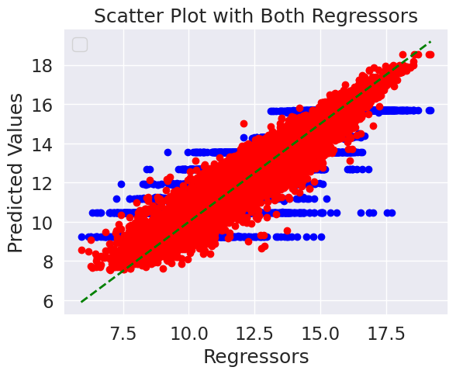
AdaBoostRegressor : Blue
HistGradientBoostingRegressor : Red
Conclusion
The initial success of the AdaboostRegressor demonstrated a good fit to the data. However, after applying hyperparameter tuning, the performance of the HistGradientBoosting Regressor improved significantly, indicating that tuning is a powerful method for finding the best-fit model.

Slide 20


